Slide 1


Have your say to improve your healthcare
The NHS Friends and Family Test
www.nhs.uk/friendsandfamily

Slide 2
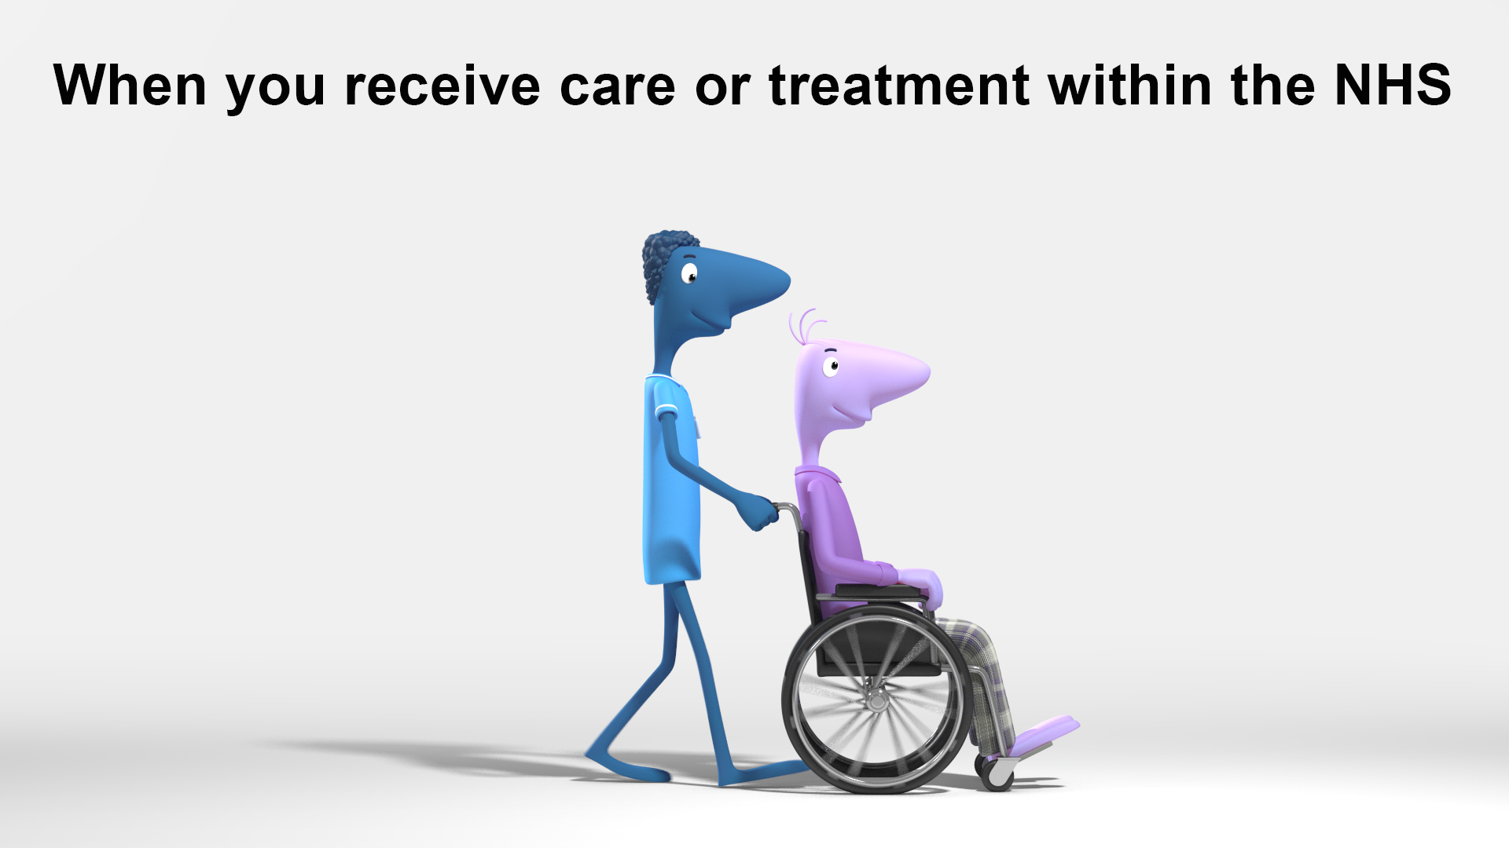
Slide 2

Slide 3
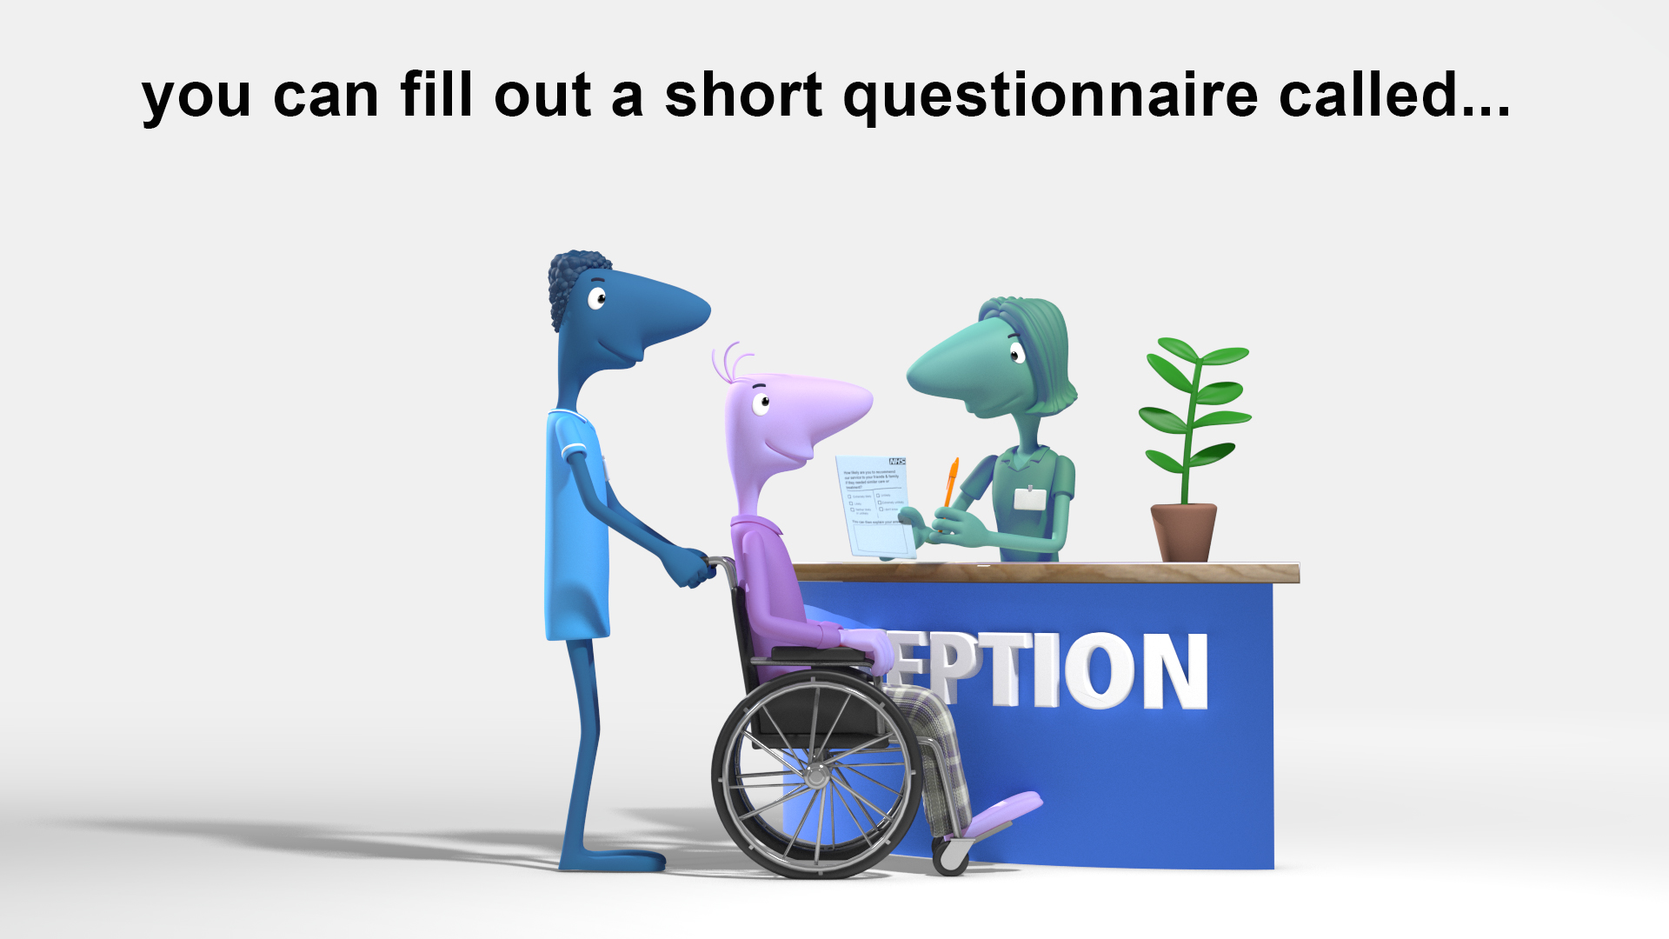
Slide 3

Slide 4
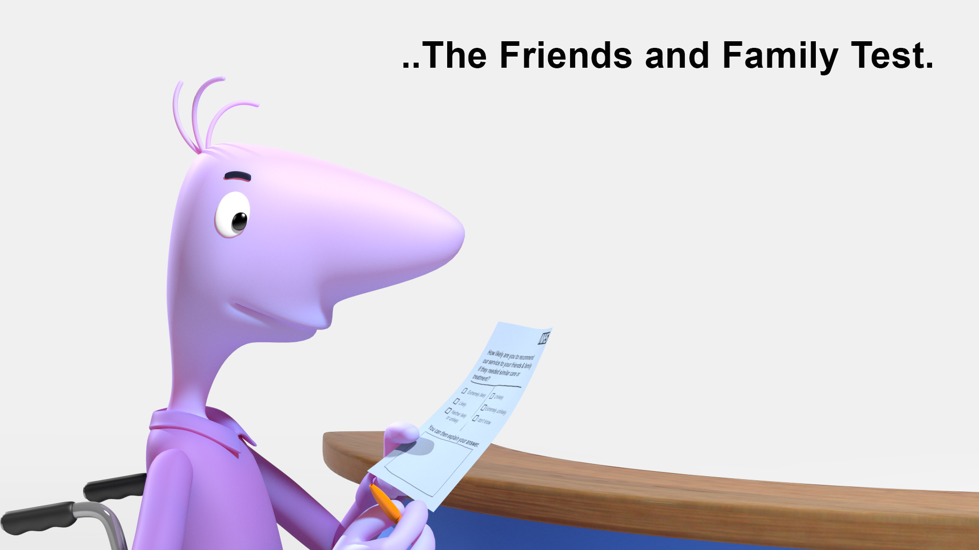
Slide 4

Slide 5
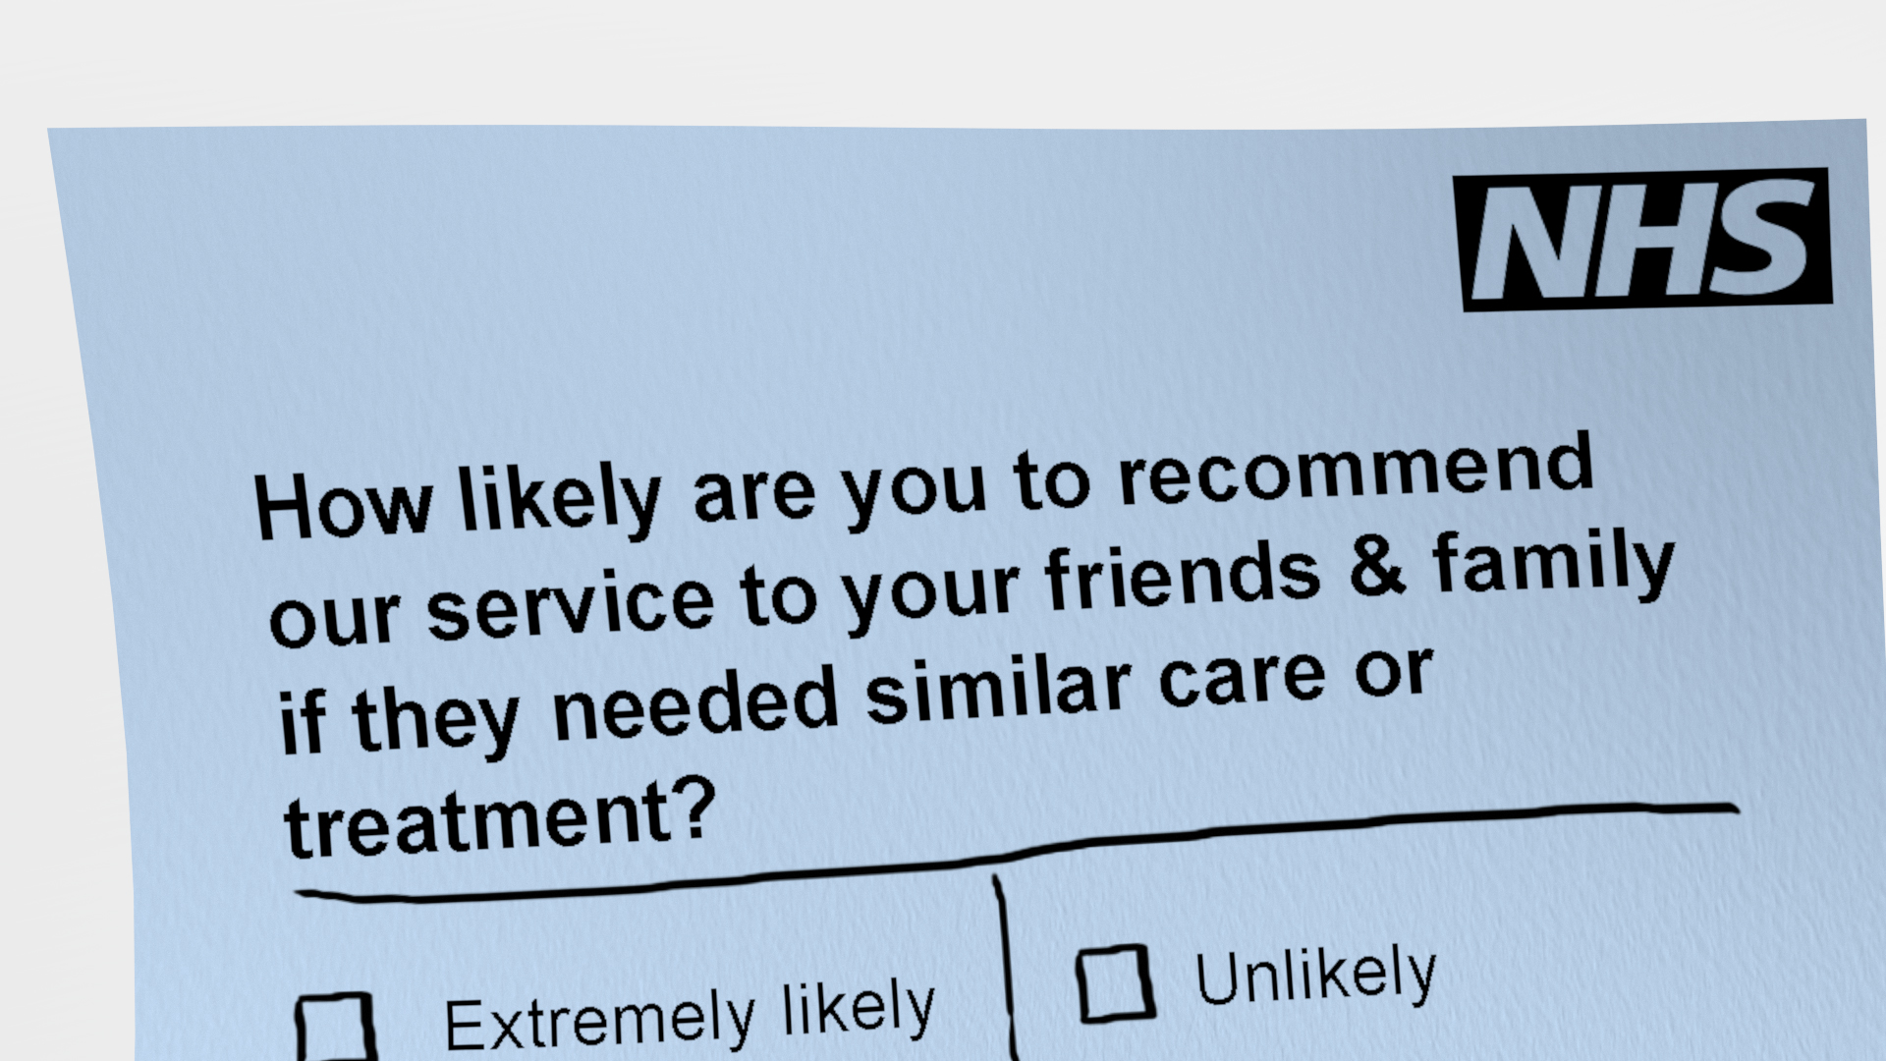
Slide 5

Slide 6
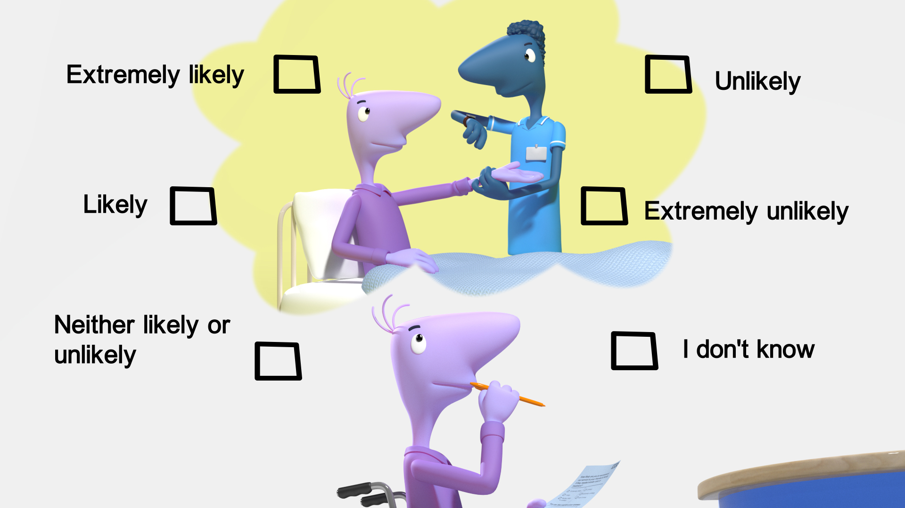
Slide 6

Slide 7
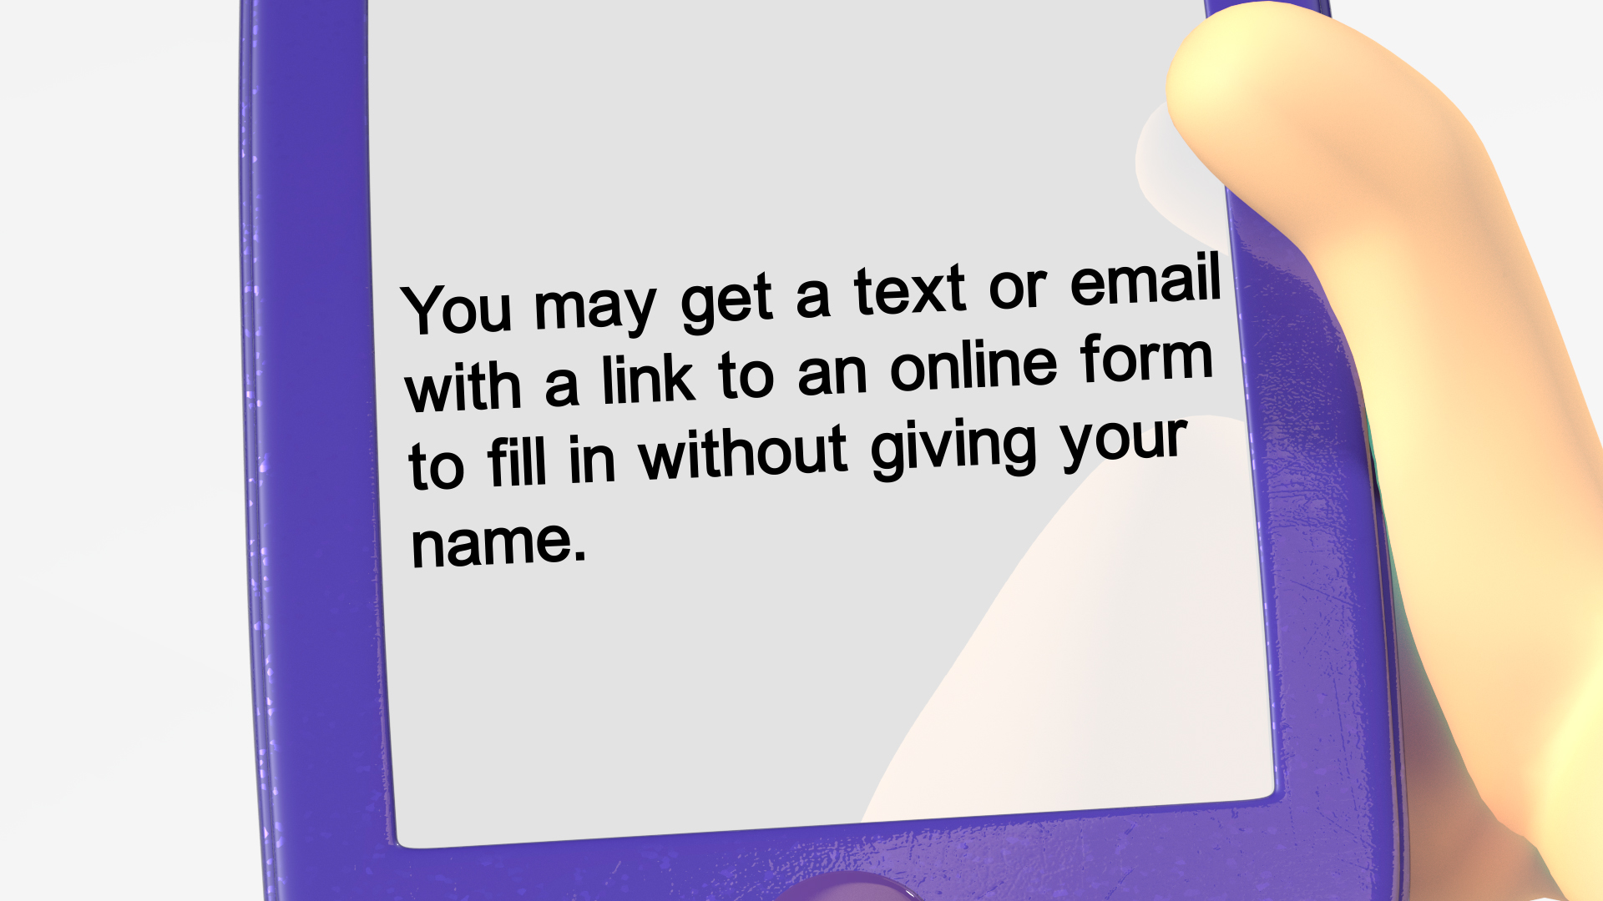
Slide 7

Slide 8
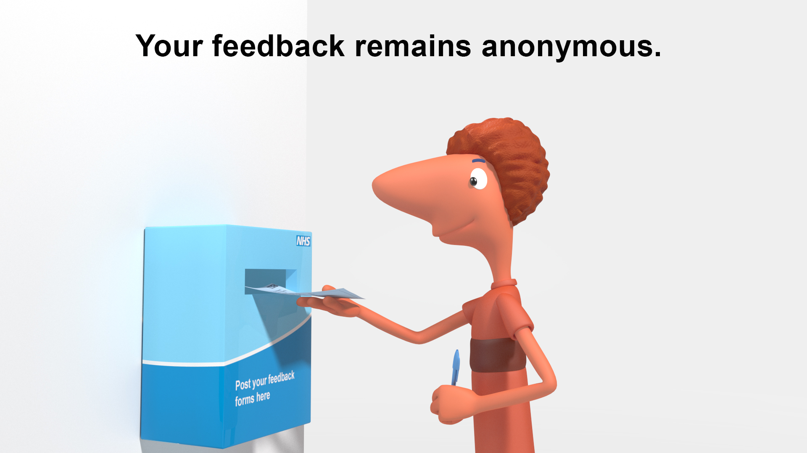
Slide 8

Slide 9
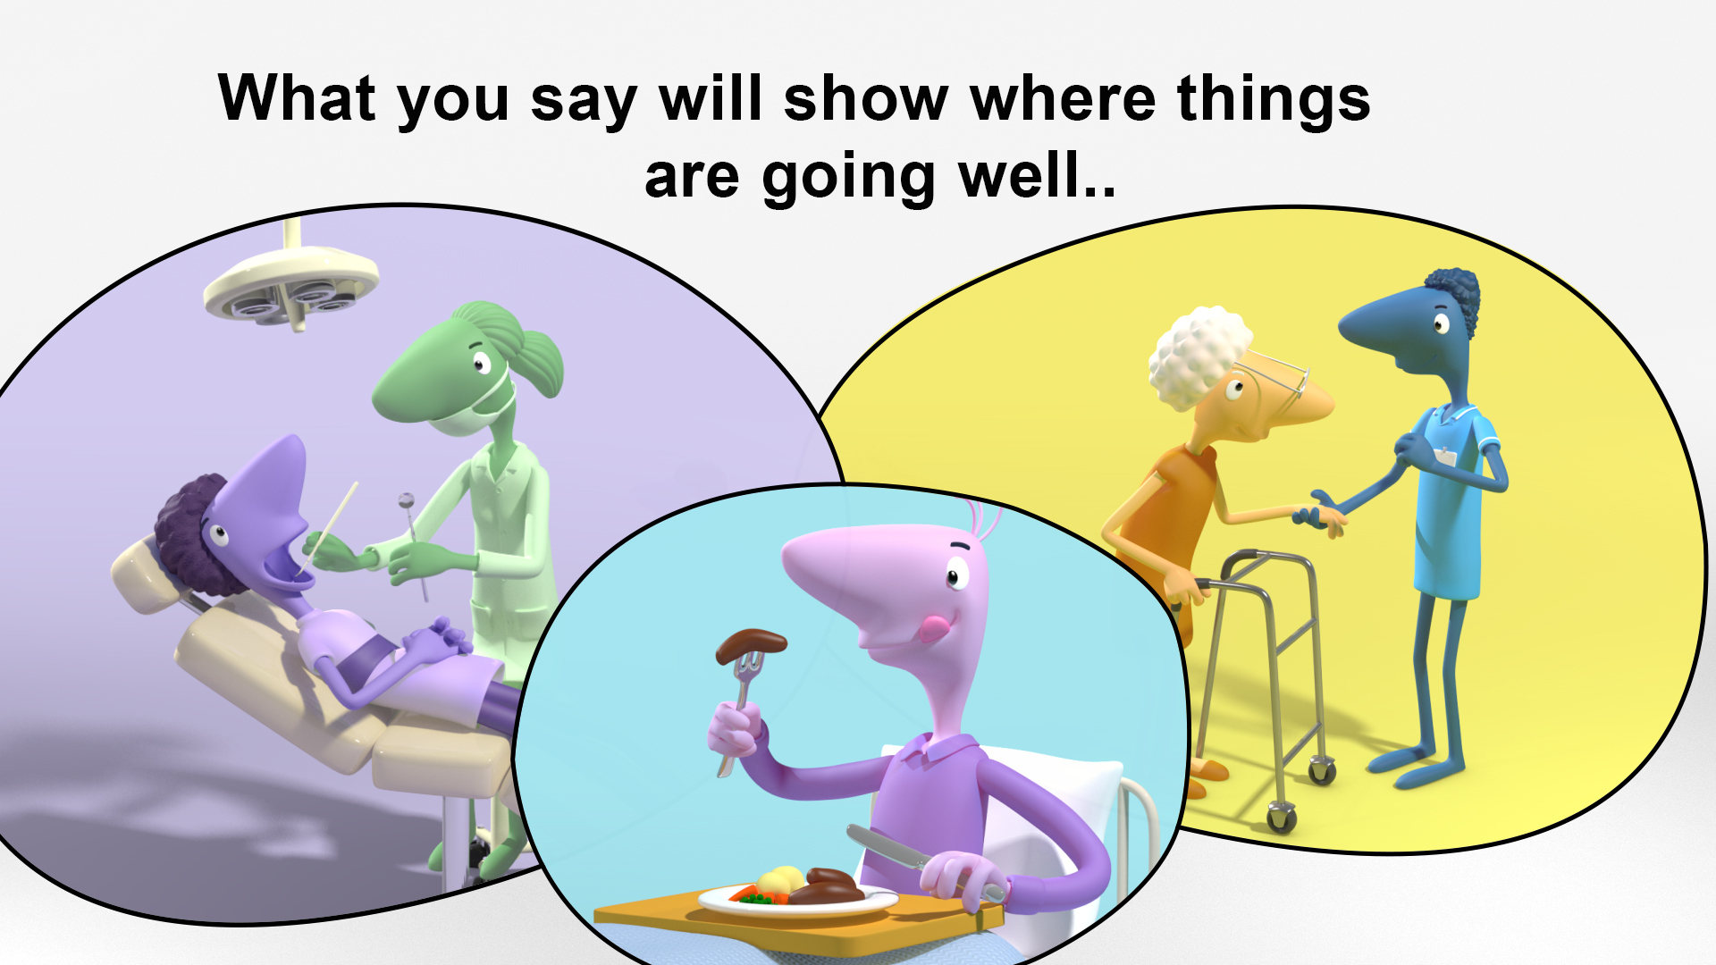
Slide 9

Slide 10
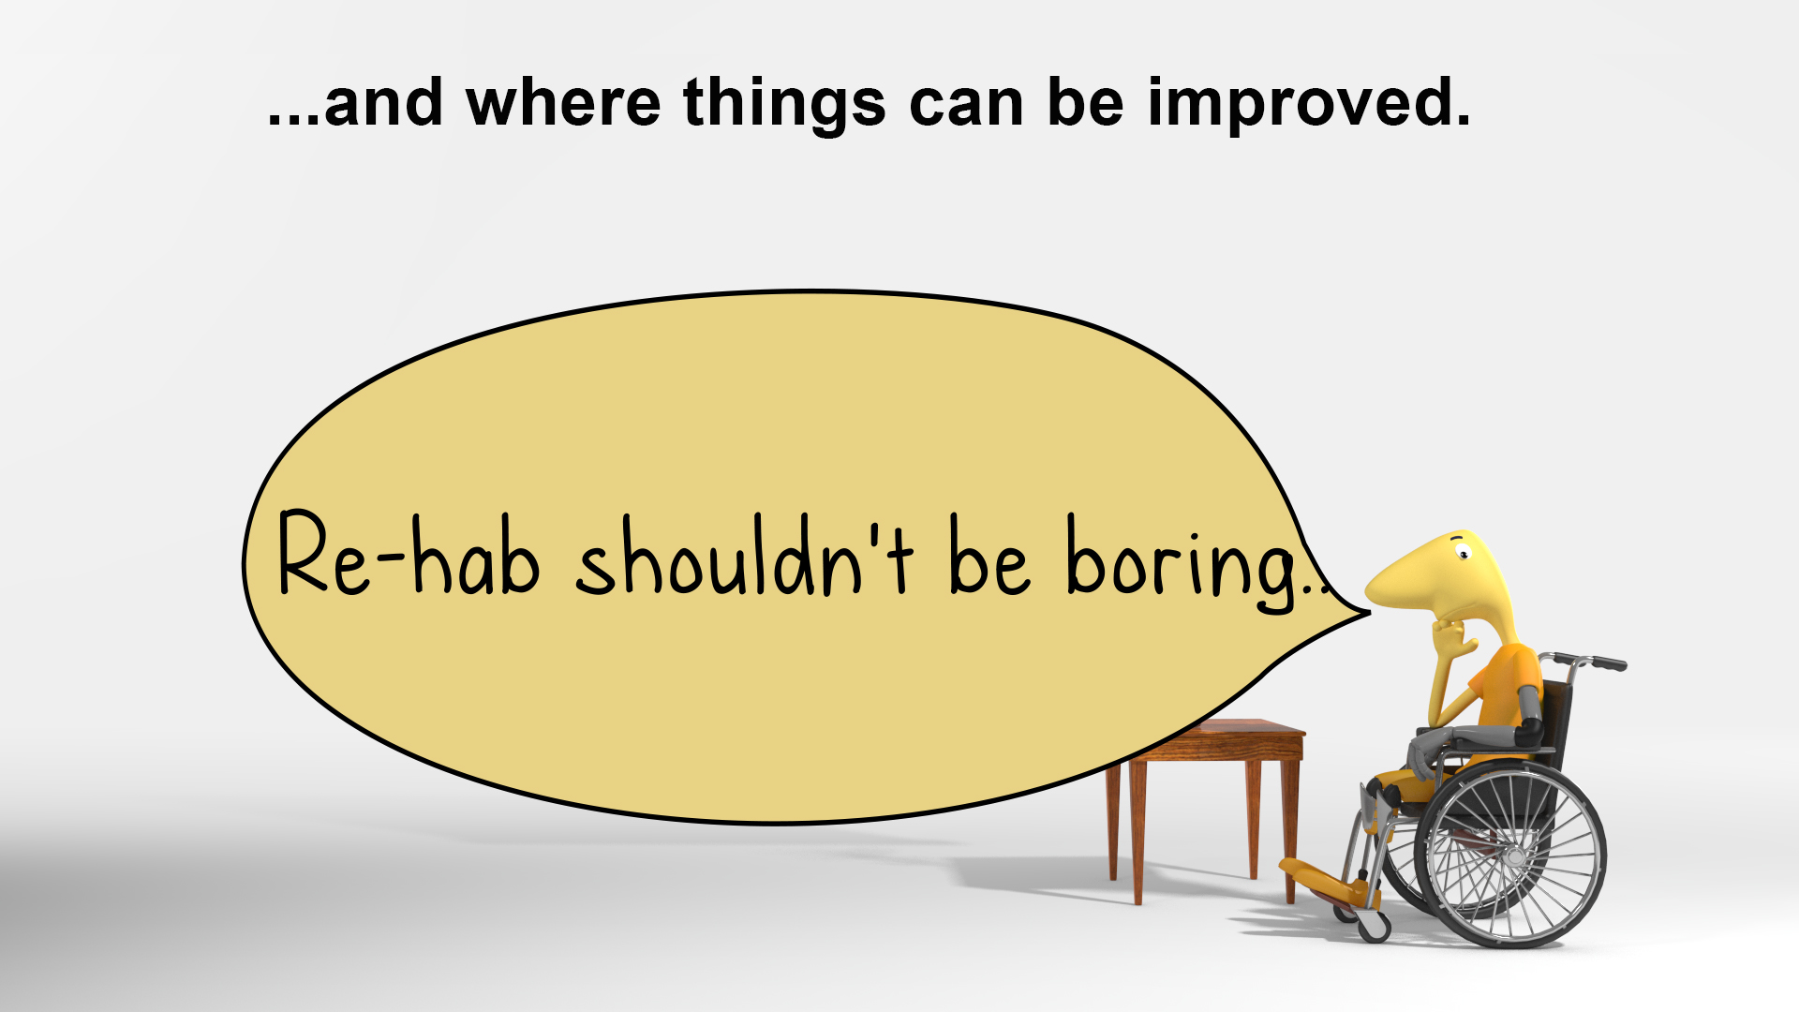
Slide 10

Slide 11
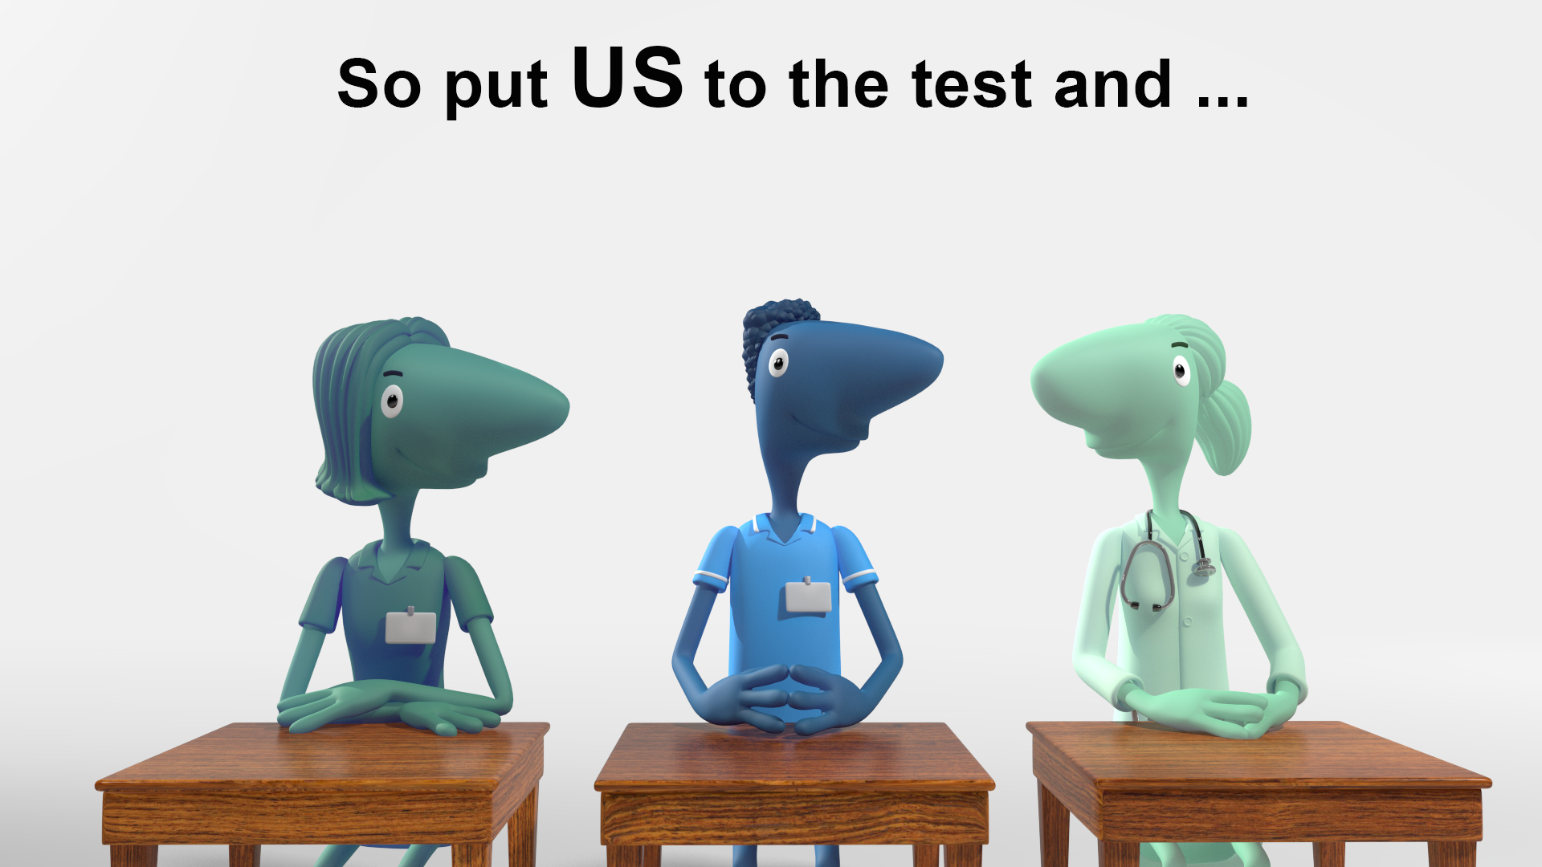
Slide 11

Slide 12
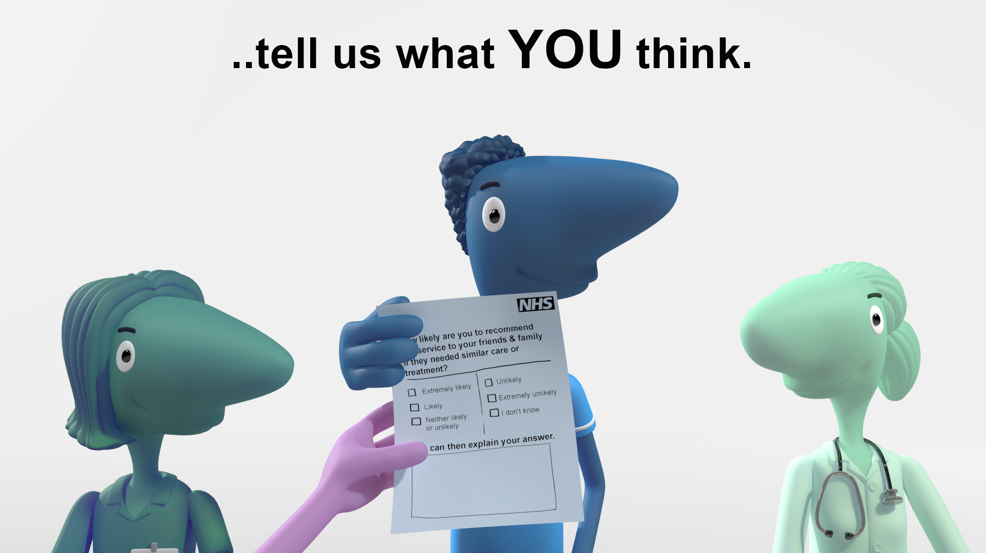
Slide 12

Slide 13

Slide 13

